Slide 1
Welcome
TANVEER AHAMED RABBY
DEPARTMENT OF COMPUTER SCIENCE AND ENGINEERING
Reg No: 18101025
Topic: what is success?
Roll No :25
Section: A

Slide 2

WHAT IS SUCCESS?

Slide 3


HOW DEFINE SUCCESS IN LIFE?
The only person that can answer the question above is you. I am neither able nor willing to prescribe the ultimate definition of success, as this is not possible. Every person is thinking differently about being prosperous in life and is defining success in another way, so there can’t exist a definition that is suitable for all. It is very important that you know exactly how to define success in life! Make yourself aware what accomplishment, success, and prosperity in general means to you in your life. Some might define success as having luxurious cars and a huge mansion, whereas others consider a life full of joy and happiness with their family as the true meaning of success. Once you have figured out what is important for you personally you are able to focus on your visions and goals.

Slide 4

THE MEANING OF SUCCESS
One of the most important key steps to achieving success in life is to know the meaning of success for your personal life. The true meaning of success goes far beyond the common definitions of success, such as having a lot of money, being wealthy, having a lot of tangibles and earned degrees. Quite the opposite: true success in life cannot be measured with the above-named factors, but instead with the amount of people that are able to live a better and more advanced life because of what you created. This is the meaning of success. Not the trophies people are collecting in their lives. Media and society let us often conclude that living a successful life means to be extraordinarily wealthy and have a lot of tangibles. But the meaning of success is to live a happy life and to make this world a better place for everyone.

Slide 5

10 THINGS SUCCESSFUL PEOPLE DO DIFFERENTLY
They commit to goals
They persist until they achieve them
They take responsibility
They work hard
Find people who are doing what they want and emulate them
They believe in themselves and their vision
They take care of themselves
They rest and recharge
They constantly learn
They make mistake and learn from them

Slide 6

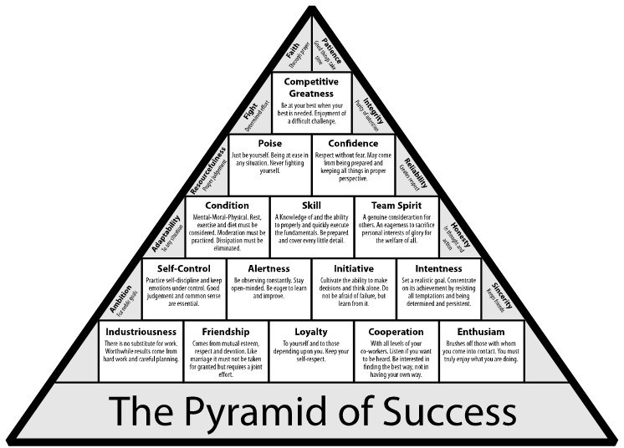
LET’S SEE

Slide 7

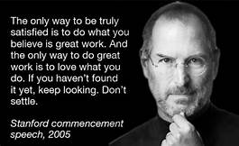

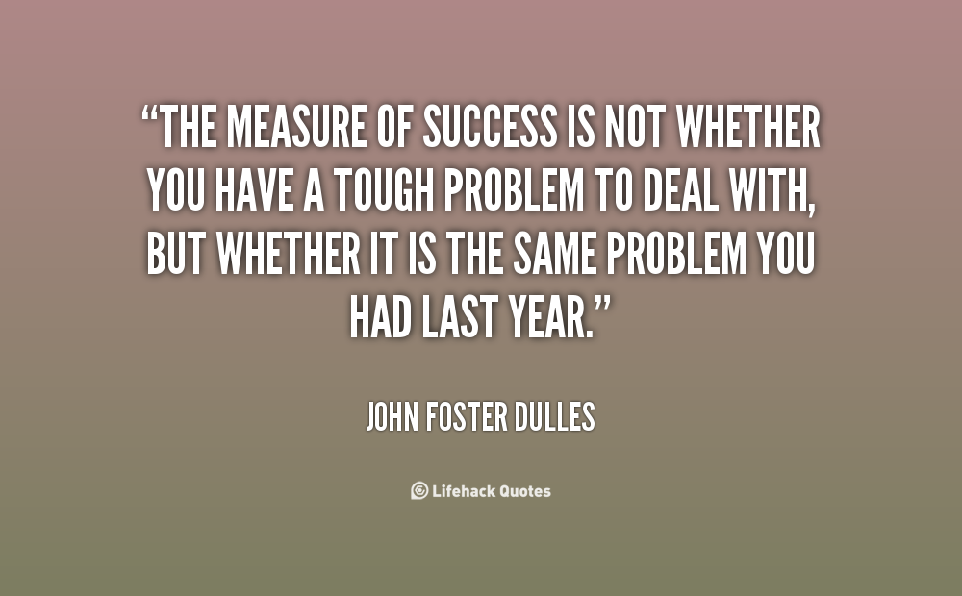
Success quotes
“Action is the foundational key to all success”.----- Pablo Picasso
“Always bear in mind that your own resolution to succeed is more important than any other”.---- Abraham Lincoln
“Defeat is not the worst of failures. Not to have tried is the true failure”.---- George Edward Woodberry
“Discipline is the bridge between goals and accomplishment”.----- Jim Roan
“Success is where preparation and opportunity meet”---- Bobby Unser
“Success is to be measured not so much by the position that one has reached in life as by the obstacles which he has overcome while trying to succeed”----- Booker T. WASHINGTON
“The path to success is to take massive, determined action”----- Jonny Robbins
“Success is not final ,failure is not fatal. It is the courage to continue that counts”----- Winston Churchill
“To be successful ,the first thing to do is to fall in love with your work”----- Sister Marry Lauretta

Slide 8


FINALLY…….
GET TO WORK
KEEP WORLING
DON’T STOP
ACHIEVE SUCCESS

Slide 9
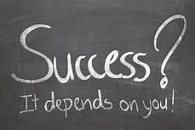

THANK YOU………

